Slide 1
Smart Car Insurance System
-Amulya Aankul

Slide 2
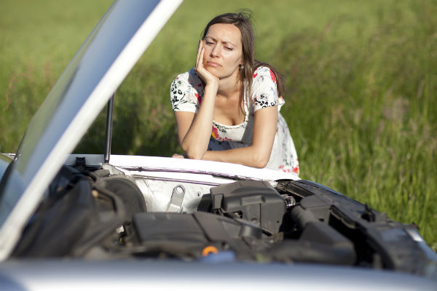
What is the problem?
We expect our cars to keep us and our families safe, but with a system of hundreds of moving parts, it is not uncommon for something to fail, often with dangerous results.

Slide 3
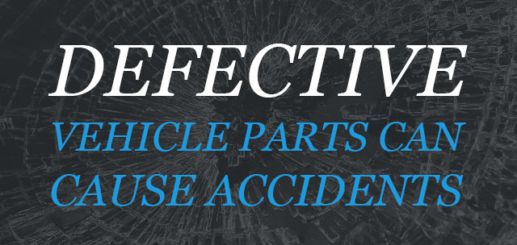
According to the National Highway Traffic Safety Administration (NHTSA), over 2.3 million people were injured in motor vehicle accidents during 2012 where a substantial number each year occur as the result of defective vehicle equipment or parts.

Slide 4
What is the solution?
A smart car insurance plan which continuously detects the health of each part and notifies the customer when there is an unusual deviation from the normal output.

Slide 5


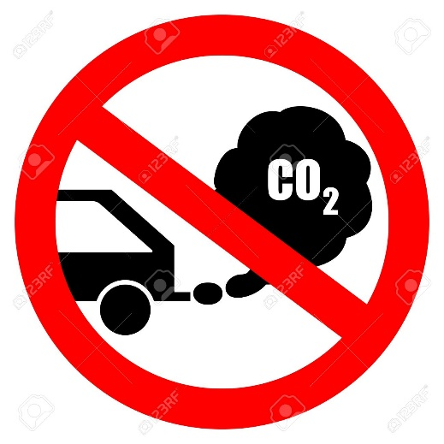
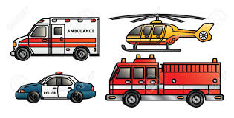
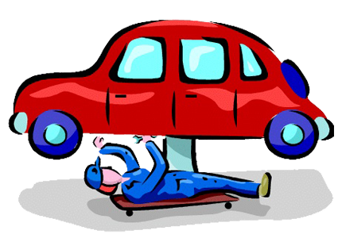
Insurance Company
Customer
Emergency control Room
Pollution control Department
Car Repair Shop

Slide 6
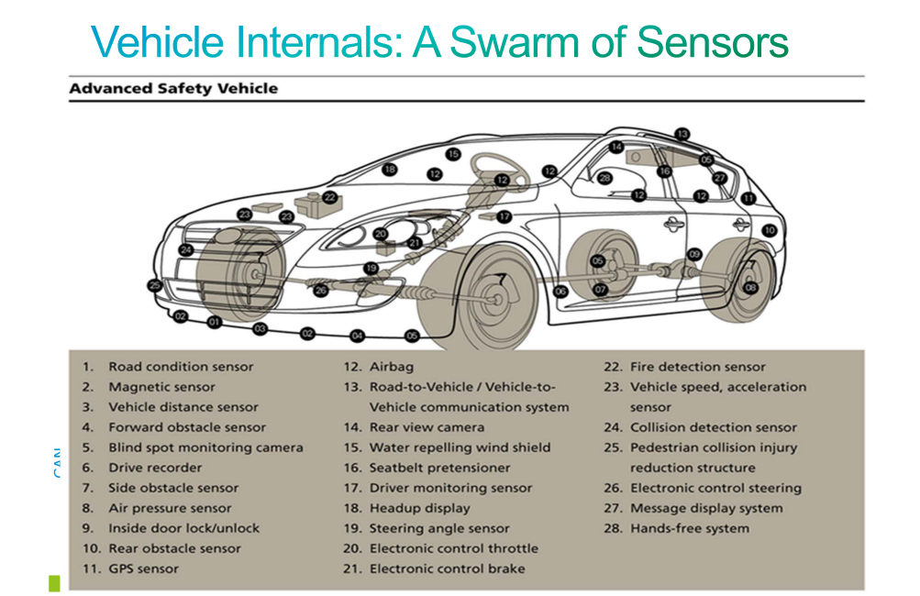

Slide 7
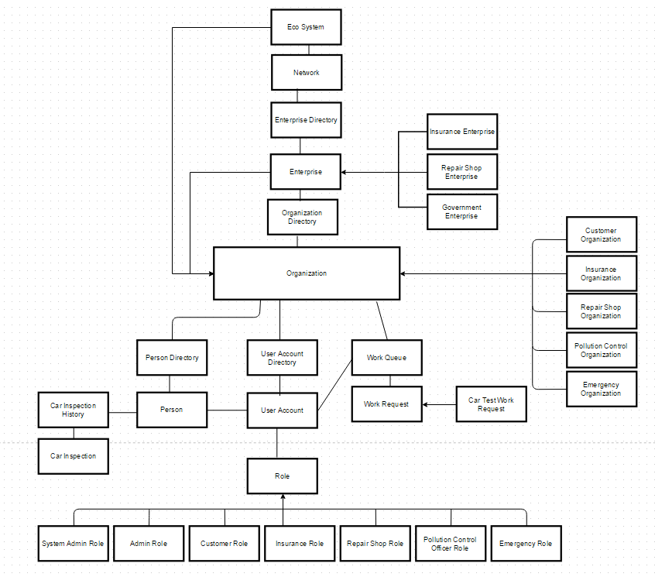
Object model

Slide 8
Key Roles
Customer
Data from the sensors present in the car.
History of data from the sensors.
History of repairs done and cost involved.
Insurance company
Receiving sensor data from customers
Identification of faults and notification to customer.
Assigning the nearest car repair shop to the customer according to the location.
Calculation of the coverage provided.

Slide 9
Car Repair Shop
Receiving the request from the insurance company
Checking the car sensor data history of the car
Fixing the car
Calculation of the total cost involved in the repairing
Pollution Control Department
Receiving the emission data from the customer.
Analyzing the data and sending an email warning to the customer for exceeding the permissible emission
Emergency Roles
Sending assistance to the customer in case of an emergency.
Calculation of exact address of the customer from the location provided by the car.

Slide 10
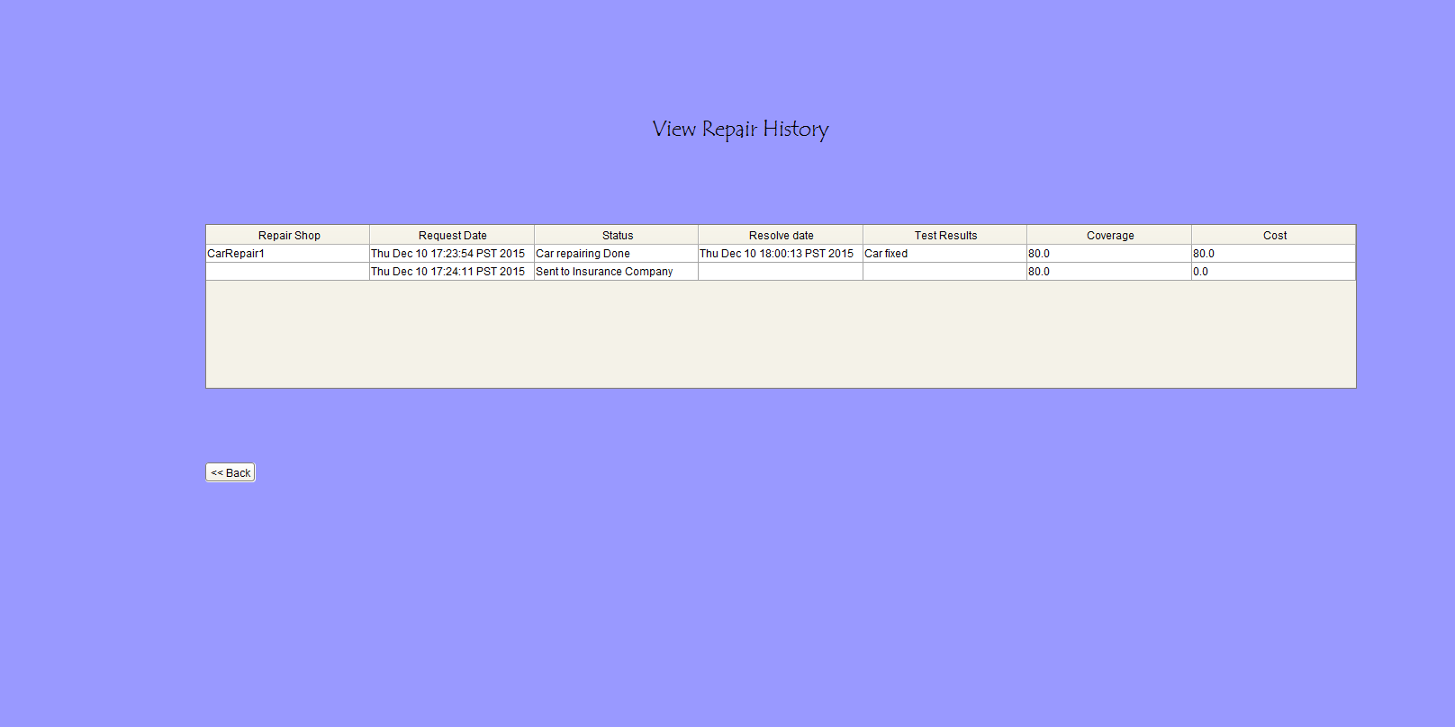
Key Features

Slide 11
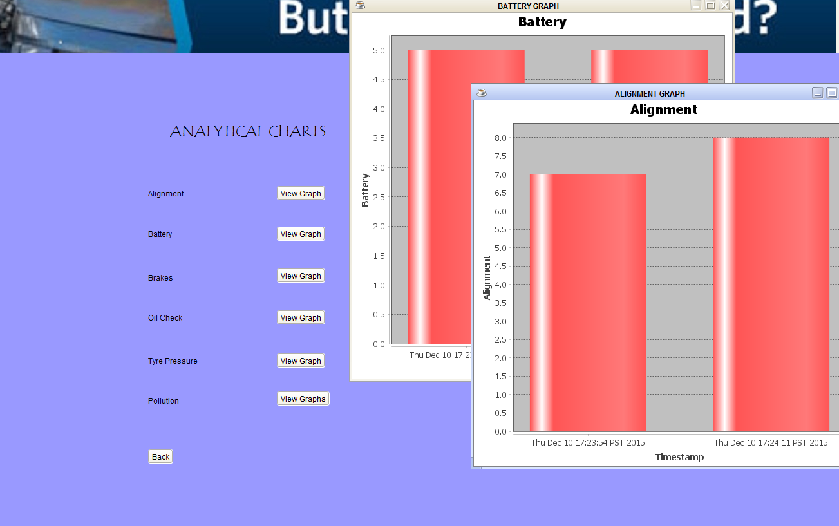

Slide 12
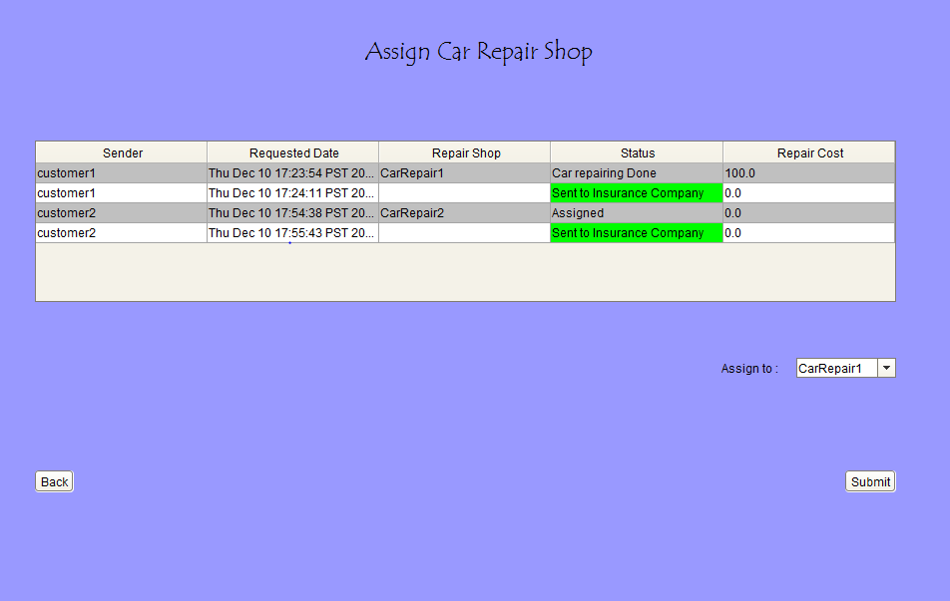

Slide 13
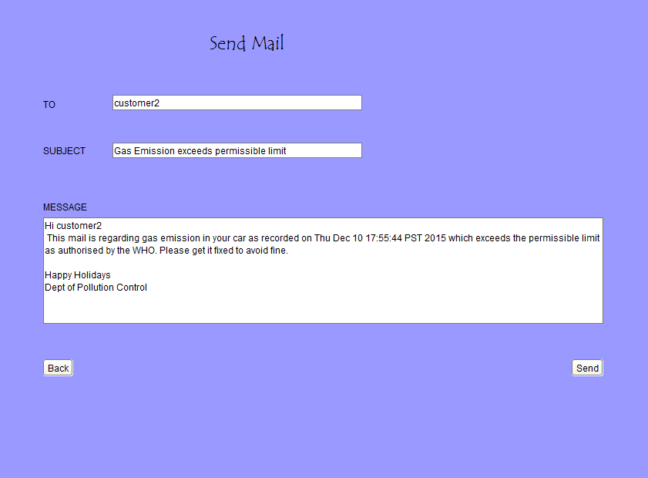

Slide 14
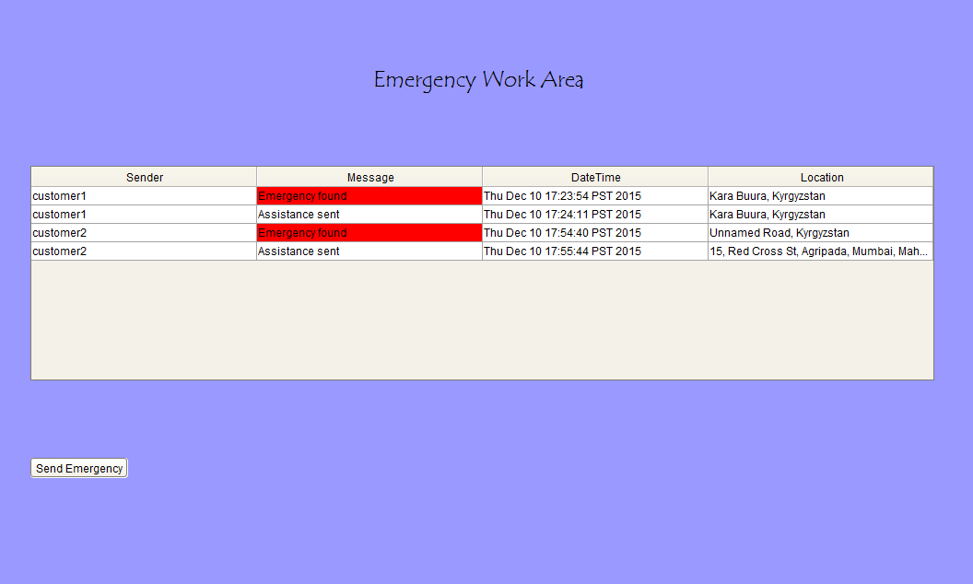

Slide 15
Thank you!!

